Slide 1





ANALYZING THE RELATIONSHIP BETWEEN REVIEW FREQUENCY AND HOTEL REVIEW SCORE
Presented by: Byte 4 Burgers🍔

Slide 2




Objective
To investigate whether review frequency has relationship with review score.
Research Question
Is there a significant relationship between review frequency and the review score (scale of 10) of customers in hotel reviews?
If so, does increased review frequency correlate with harsher
or more lenient scores? How deep is the relationship?
Are there any confounding variables?

Slide 3


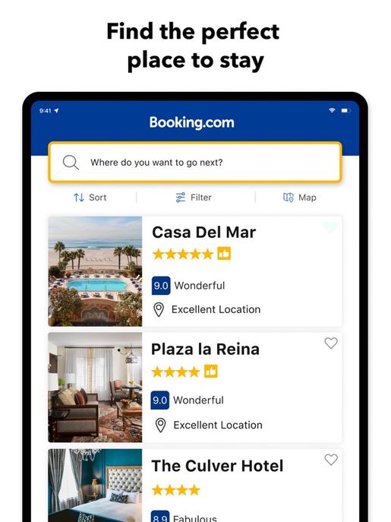

Importance of The Study
Our study aims to improve OTA rating and recommendation systems by investigating whether frequent reviewers provide harsher reviews than first-time reviewers. If frequent reviewers are found to offer more critical and credible feedback, OTAs can adjust their algorithms to prioritize these reviews, ensuring that hotels with positive reviews from experienced users are more prominently featured.
This approach would improve the accuracy and reliability of recommendations, offering travelers more personalized suggestions while increasing hotel visibility.
Ultimately, this study could optimize both the traveler experience and hotel exposure, leading to better bookings and customer satisfaction.
Notes:
The importance of this study lies in its potential to significantly enhance the effectiveness of OTA (Online Travel Agency) rating and recommendation systems. By addressing the research question—whether frequent reviewers tend to provide harsher reviews than first-time reviewers—we aim to uncover key insights that could reshape how OTAs evaluate and recommend hotels.
If frequent reviewers consistently offer more critical assessments, and if their reviews demonstrate higher credibility, OTAs can adjust their algorithms to give more weight to reviews from experienced users. This would ensure that hotels with favorable feedback from credible, experienced reviewers are more prominently featured in the recommendation system. In turn, this would lead to more accurate, reliable, and personalized recommendations for travelers.
Additionally, by distinguishing between frequent and first-time reviewers, OTAs can refine their approach to hotel exposure, offering better visibility to hotels that meet the standards of seasoned reviewers. This approach not only benefits consumers by offering them higher-quality suggestions but also enhances hotel exposure based on credible review sources, ultimately driving more bookings and improving customer satisfaction.
Through this study, we aim to improve the overall travel experience by increasing the precision of recommendations, ensuring that both hotel visibility and traveler trust are optimized.

Slide 4
HYPOTHESES & POSSIBLE OUTCOMES
Possible Outcomes | Implications
Frequent reviewers give harsher scores (Negative relationship) | Experienced reviewers develop higher expectations and a more critical approach over time
Frequent reviewers give more lenient scores (Positive relationship) | Experience in reviewing makes travelers more forgiving of minor flaws, possibly due to familiarity with industry standards
No significant difference (No relationship) | Implies that scoring behavior is independent of review frequency, suggesting that personal expectations and individual experiences play a greater role than the number of reviews written

Slide 5

Nationality
Seasonality
Service
Price Fluctuation
Room type
Motivation
Stay time
Amenities
Travel Type
…
Review Frequency
(Total Numbers of Reviews customers gave)
Review Scores

Slide 6


Ideal Experiment Setting
Participant Selection
Randomly select guests for the study, ensuring a balanced mix of:
Treatment Group: Frequent reviewers (guests with a history of leaving multiple reviews).
Control Group: First-time reviewers (guests who have never left a review before).
All other factors (e.g., booking experience, location, price, room type, nationality, age group, seasonality...) should remain consistent across groups.
A small, non-coercive incentive (e.g., future booking discount/ point reward) is provided to encourage participation. The incentive must be minimal to avoid influencing review scores.
Data Collection
Gather review scores and qualitative feedback from both groups.
Optionally, implement a star rating survey during check-out to collect structured responses.
Analysis & Evaluation
Compare review scores and content between frequent and first-time reviewers and discover whether they have linear relationship or other relationships .
Identify potential differences in rating patterns, sentiment, and review length.

Slide 7
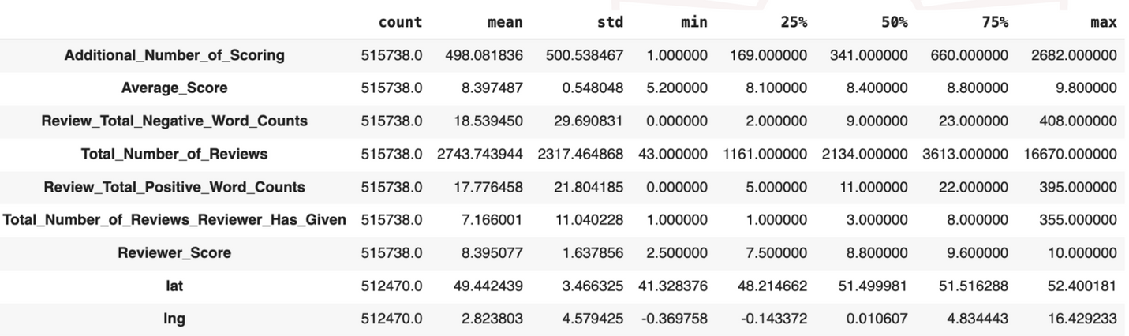
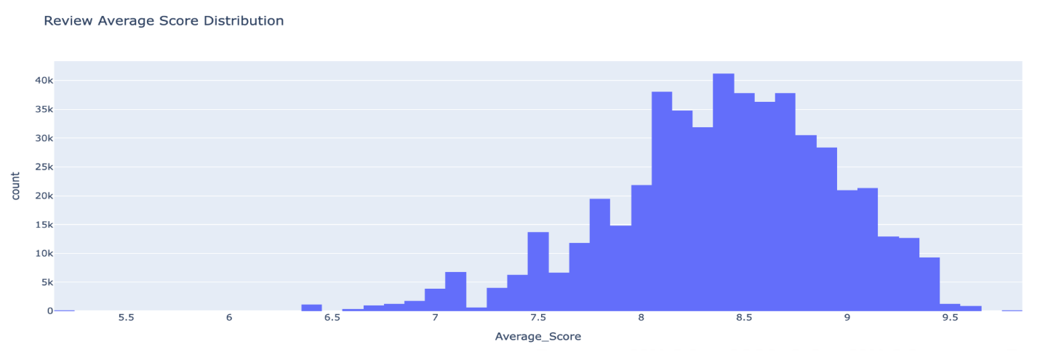
DATASET & DESCRIPTIVE STATISTICS
The data was scraped from Booking.com. All data in the file is publicly available to everyone already. This dataset contains 515,000 customer reviews and scoring of 1493 luxury hotels across Europe. Meanwhile, the geographical location of hotels are also provided for further analysis.
As you can see, the majority of reviews cluster between 7.5 and 9. This suggests that, overall, customers tend to rate their luxury hotel experiences quite favorably. However, we do see a small tail of lower scores, indicating some dissatisfaction among certain reviewers.
Source: https://www.kaggle.com/datasets/jiashenliu/515k-hotel-reviews-data-in-europe/data

Slide 8
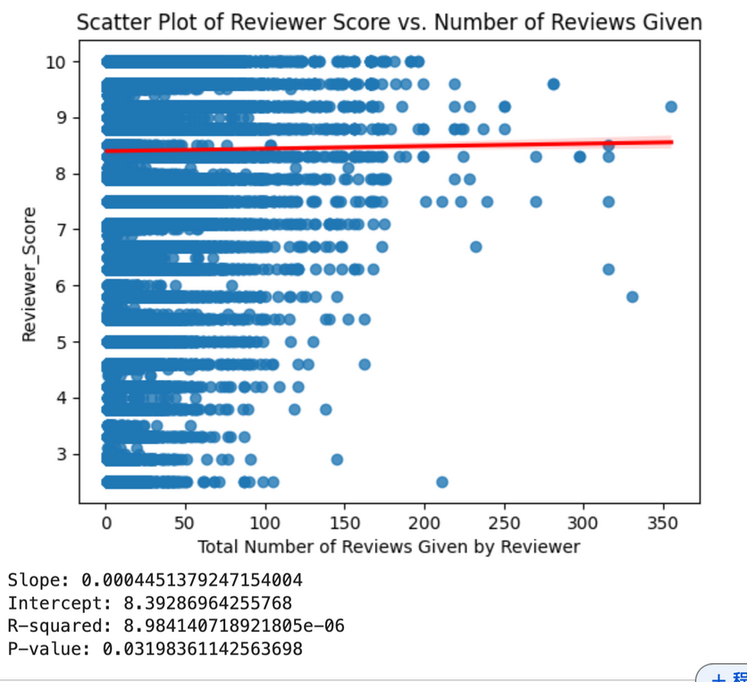
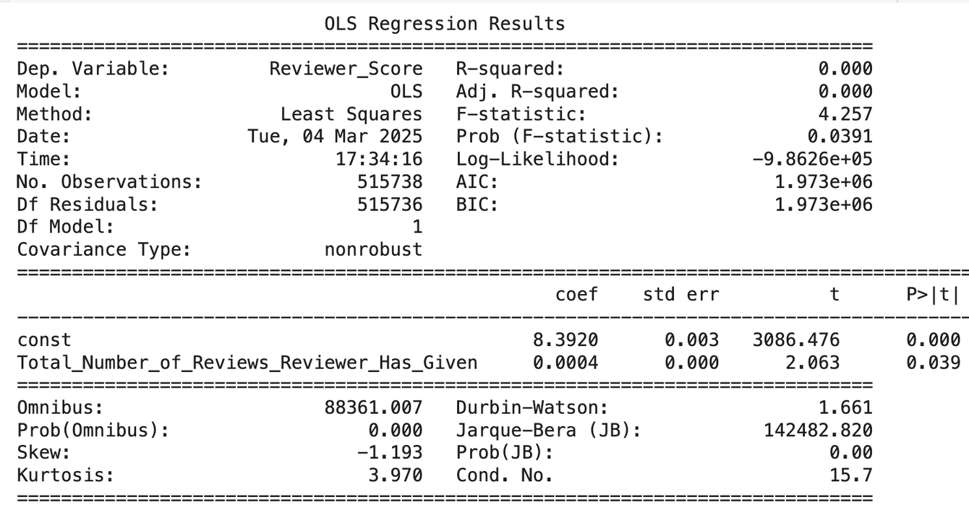
SLR Analysis
Slope (Coefficient): 0.0004 (very small positive effect)
Intercept: 8.392 (baseline score when the number of reviews given is zero)
R-squared: 0.000 (almost no explanatory power, meaning the number of reviews given does not predict reviewer scores well)
P-value for Coefficient: 0.039 (statistically significant at the 5% level, suggesting a weak but significant relationship)
P-value for Model: 0.000 (overall model significance, but very weak explanatory power)
While the number of reviews given by a reviewer has a statistically significant but tiny positive impact on the reviewer score, the effect is negligible in practical terms. The model explains almost none of the variation in reviewer scores.

Slide 9


Conclusion
There is a statistically significant but negligible positive correlation between the number of reviews a customer has written and their hotel review score.
Our findings suggest that review frequency does not meaningfully influence review scores, meaning frequent reviewers do not significantly differ in scoring behavior from infrequent reviewers.
This suggests that other factors, such as individual preferences, hotel service quality, or regional trends, may have a stronger influence on review scores.
For OTAs and hotels, prioritizing reviews from frequent reviewers in rating algorithms may not substantially improve the accuracy of hotel rankings.

Slide 10
Limitations and Future Improvements
Limitations
The dataset includes only luxury hotels in Europe, which may not generalize to other hotel segments or regions.
The analysis focuses on quantitative scores but does not evaluate textual review sentiment, which could provide deeper insights
Future Improvements
Investigate the influence of qualitative review sentiment (e.g., through sentiment analysis) rather than just numerical scores.
Comprehend the scoring system to analyze ratings across multiple aspects, including: Service, Room quality, Location, etc.
Assess whether external factors like seasonality, pricing, or service quality variations have a stronger influence on review scores than reviewer experience. If so, add interaction terms to our model.
Expand the dataset to include a wider range of hotel types and regions, such as budget hotels, boutique hotels, and properties from North America, Asia, and other regions.

Slide 11



THANK YOU FOR LISTENING!

